Slide 1

Placing a taco stand
Using Foursquare API
and K-means clustering algorithm

Slide 2
Introduction
Are you going to open a restaurant, but you do not know where to place it?
Locating a restaurant has never been an easy task.
Now days we have Foursquare!! This API lets us gather venue data for any specific regions, using this API you have data in minutes about nearby restaurants, gyms, all types of restaurants, bars, etc.
In this project I will get the best location to place a taco stand in South California

Slide 3
Data and References
Using google maps [1] we selected longitude and latitude was around Los Angeles, CA.
In order to retrieve information from every city and postal code we used the web page Open data soft [2] and we got all the postal codes for the entire California.
Also, we analyzed some information about the income of the people living in the surrounding areas. [3]
Finally, for the heuristics of how to select a good locations we used this guide made by restaurant engine [4]

Slide 4
Methodology
Define a selected area to analyze
Explore the nearby venues with the Foursquare API
Define our targeted audience
Filter our data regarding the audience
Cluster the information using K-means algorithm
Match the result with the IRS household income data
Select the resulting top 3 location candidates

Slide 5
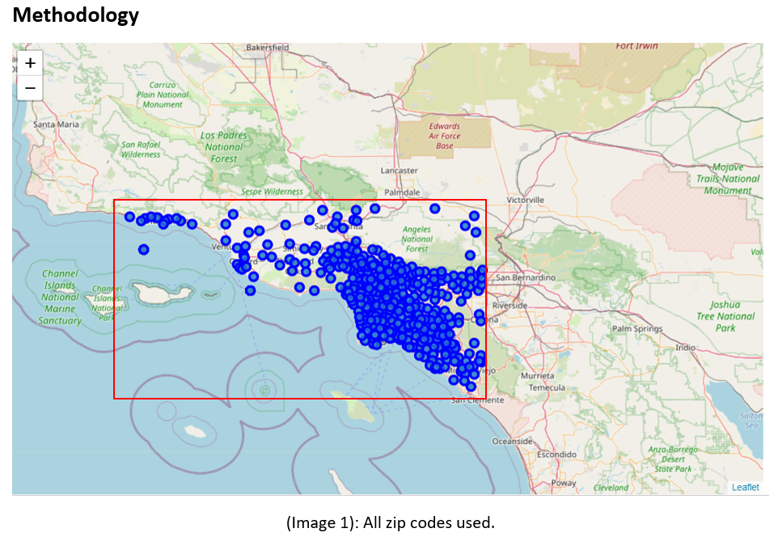
Area used

Slide 6
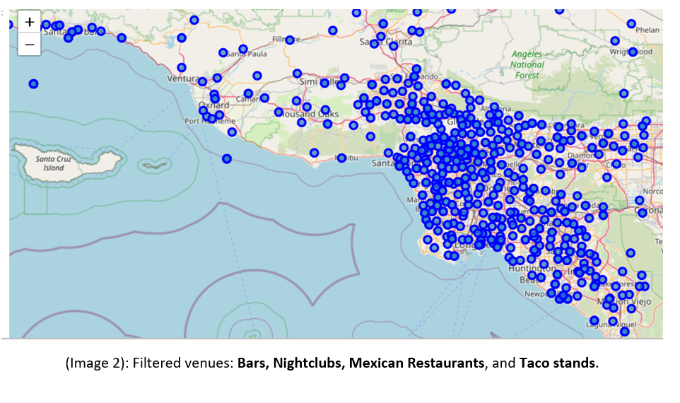
Bars, nightclubs, Mexican Restaurants and Taco stands

Slide 7
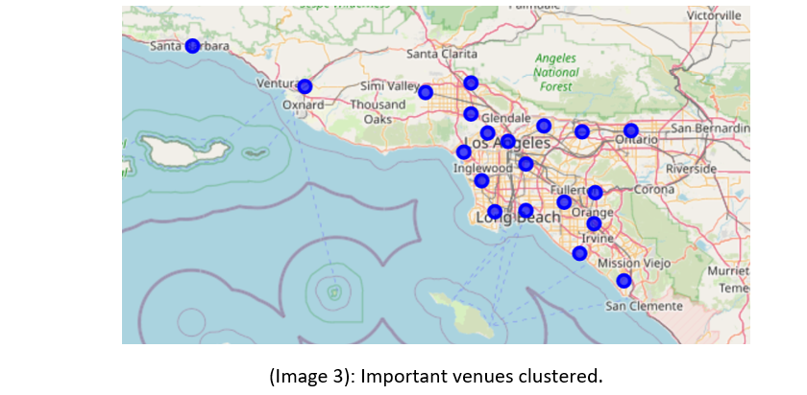
Clustered venues

Slide 8
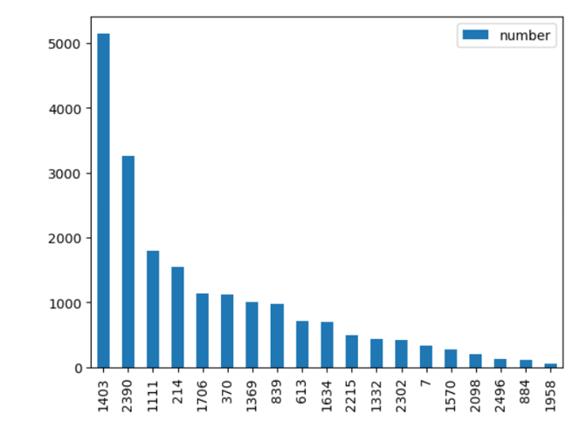
Number of households earning $100,000 near each location

Slide 9
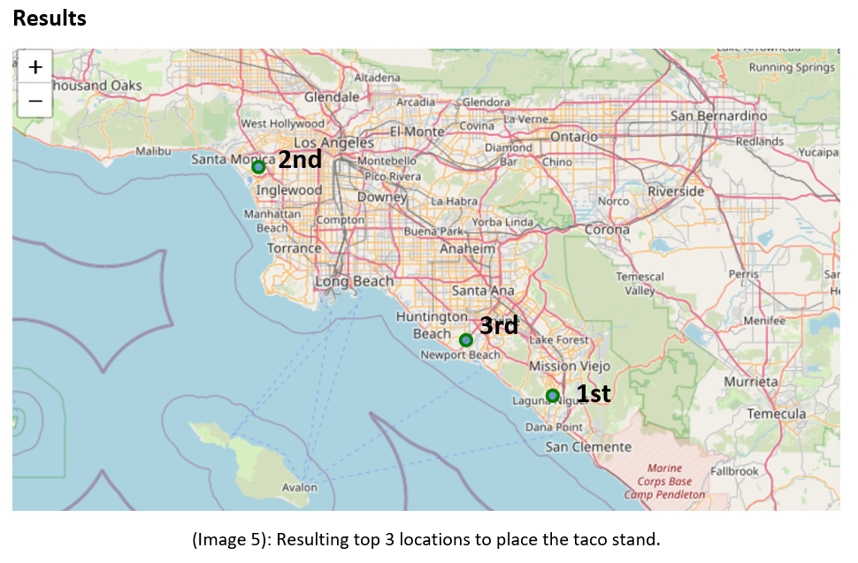
Results

Slide 10
Conclusions and observations
Foursquare API is awesome
Is 20 the optimal number to cluster all the venues ? *Elbow method could solve this doubt
Increasing the search radius from the Foursquare API might change the results a certain percentage.
Better targeting of our audience could change the results
If the taco stand is positioned at the spotted areas, the client just needs to focus on delivering high quality tacos. That will make a good reputation around the area and will continue to have business in the future years to come.

Slide 11
References
"Google maps," [Online]. Available: https://www.google.com/maps/.
"Open data soft," [Online]. Available: https://public.opendatasoft.com/explore/dataset/us-zip-code-latitude-and-longitude/export/?refine.state=CA.
"USA IRS Zipcode data," [Online]. Available: https://public.opendatasoft.com/explore/dataset/usa-irs-zipcode-data/table/?disjunctive.zipcode&disjunctive.agi_group&disjunctive.name.
"Restaurantengine," [Online]. Available: https://restaurantengine.com/great-restaurant-location/#:~:text=Consider%20the%20downtown%20location%2C%20or,usually%20good%20spots%20for%20restaurants..

